Slide 1
Object Technology
Dr. Priti Srinivas Sajja
Professor, Department of Computer Science,
Sardar Patel University,
Vallabh Vidyanagar, Gujarat, India.

Slide 2
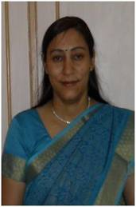
Contact
Name: Dr. Priti Srinivas Sajja
Communication:
Email : priti@pritisajja.info
Mobile : +91 9824926020
URL :http://pritisajja.info
Academic qualifications : Ph. D in Computer Science
Thesis title: Knowledge-Based Systems for Socio-
Economic Development
Subject area of specialization : Artificial Intelligence
Publications : 216 in International/ National Conferences,
Journals & Books

Slide 3
Unit 1: Object Modeling
Key concepts of Object Modeling
Introduction to UML, Types of UML diagrams - structural and behavioral
Structural UML Diagrams - Class diagram, Object diagram
Behavioral UML Diagrams – Use case diagram, Activity diagram, Sequence diagram

Slide 4
Key Concepts
Objects:
Executable software representations of real world objects and concepts.
Examples are students, chair, promise, book, account, etc.
Messages:
An uniform communication means thru which objects interacts with each other.
Examples are query(), teach(), issue_book(), deposit(), etc.
Classes:
Templates for defining similar objects, providing the bases for abstracting the common characteristics of real world objects.
Examples are Student, Book, Account, etc.

Slide 5
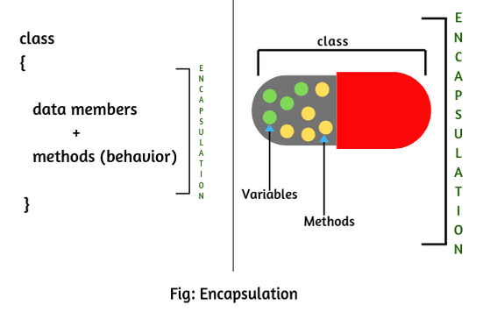
Key Mechanisms
Encapsulation:
Packaging related data and procedure in an object
Methods are as covering the data as black box.
This supports information hiding.
https://www.scientecheasy.com/

Slide 6
Key Mechanisms
Encapsulation Advantages:
Information hiding
Clean, easy to develop/test and maintain code
Flexibility to change
Security, as it prevents the other classes to access the private fields. Also it keeps the data and codes safe from external inheritance.

Slide 7
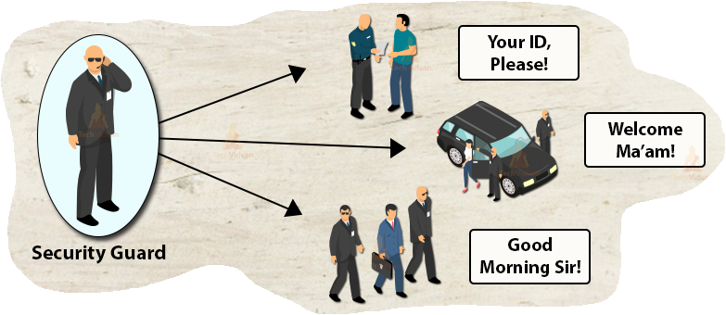
Key Mechanisms
Polymorphism:
Ability to implement same message in different way in different object
https://techvidvan.com/

Slide 8
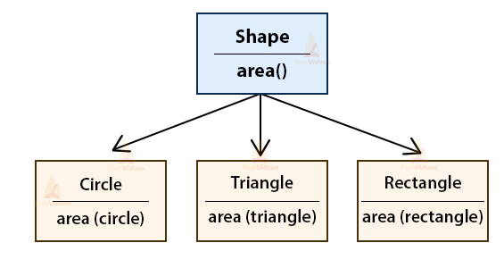
Key Mechanisms
Polymorphism:
Area method name is same but plays different role as per its implementation at different places
https://techvidvan.com/

Slide 9
Key Mechanisms
Polymorphism Advantages:
Reducing size and complexity
Faster as the program code compiles down to a direct jump to the appropriate procedure.
Flexible, as more financial instruction can be added or removed without re-writing the code.
Code maintainability

Slide 10
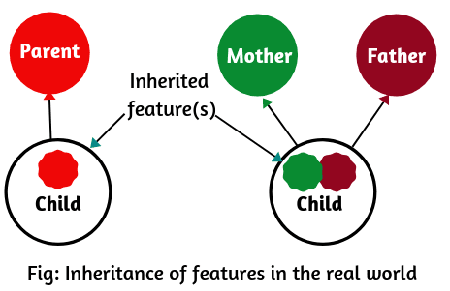
Key Mechanisms
Inheritance:
Disseminating information defined in generic classes to other classes
https://www.scientecheasy.com/

Slide 11
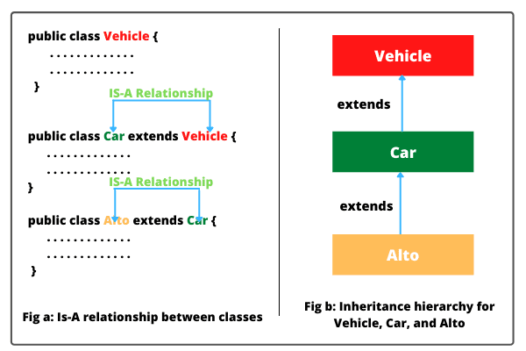
Key Mechanisms
https://www.scientecheasy.com/

Slide 12
Key Mechanisms
Inheritance Advantages:
Reusability: Define once and use many times
Organization of information in hierarchical manner
Easy to develop/test and maintain the code
https://www.scientecheasy.com/

Slide 13
Introduction to UML
Unified Modeling Language (UML) is a general purpose modeling language.
The main aim of UML is to define a standard way to visualize the design of a system.
It is like blueprints used in engineering to show design of a building.

Slide 14
UML Diagram Types
Diagrams in UML can be broadly classified as:
Structural Diagrams
Describes structure of a system.
More static in nature.
Structural Diagrams include: Component Diagrams, Object Diagrams, Class Diagrams and Deployment Diagrams.
Behavior Diagrams
Describes behavior of the system.
Behavior diagrams include: Use Case Diagrams, State Diagrams, Activity Diagrams and Interaction Diagrams.

Slide 15
Class Diagram
Class diagram
Represents design of class
Student Class
Class Name
Student
Attributes
PID: String
Name: String
M1,M2, M3, M4, M5, M6: int
Methods
Admission()
Query()
Exam()
View_result()

Slide 16
Class and Object Diagram
Student Class
Student S1
Student
S1 (Student)
PID: String
Name: String
M1,M2, M3, M4, M5, M6: int
PID: D22022
Name: Ramesh Patel
M1=80,M2=80, M3=80, M4=80, M5=80, M6=80
Admission()
Query()
Exam()
View_result()
Admission()
Query()
Exam()
View_result()

Slide 17
Class Diagram
Employee
Employee
Class Name
Empno: int
Name: String
Basic: Double
Jdate: String
Attributes
Methods
Attendance()
Work()
Salary()

Slide 18
Class and Object Diagram
Employee Class
Employee PSS
Employee
PSS (Employee)
Empno: int
Name: String
Basic: Double
Jdate: String
Empno: 999
Name: XXX YYY
Basic: 50000.00
Attendance()
Work()
Salary()
Attendance()
Work()
Salary()

Slide 19
Class and Object Diagram
Employee Class
Employee DBS
Employee
DBS (Employee)
Empno: int
Name: String
Basic: Double
Jdate: String
Empno: 888
Name: AAA BBB
Basic: 40000.00
Attendance()
Work()
Salary()
Attendance()
Work()
Salary()

Slide 20
Other Class Diagrams
Homework: Prepare an object diagrams of (i) Book class called B1 and an object diagram of (ii) Account class called A1.
Book
Account
Book
Account
Bookno: String
Name: String
Author: String
Price: double
Accno: int
Name: String
Balance: double
Type: char
Purchase()
Issue()
Return()
Open()
withdraw ()
deposit ()
Query()

Slide 21
Relation between Class Diagrams
Book
Student
Book
Student
Bookno: String
Name: String
Author: String
Price: double
PID: String
Name: String
M1,M2, M3, M4, M5, M6: int
n
1
Purchase()
Issue()
Return()
Admission()
Query()
Exam()
View_result()

Slide 22
Relation between Class Diagrams
Teacher
Student
Class diagrams and object diagrams are structural diagrams, which are static in nature and shows structure of a class/object and relationship between classes/objects.
Teacher
Student
T_id: int
Name: String
Jdate: String
Degree: String
PID: String
Name: String
M1,M2, M3, M4, M5, M6: int
1
n
Teach ()
Exam()
Check ()
Admission()
Query()
View_result()

Slide 23
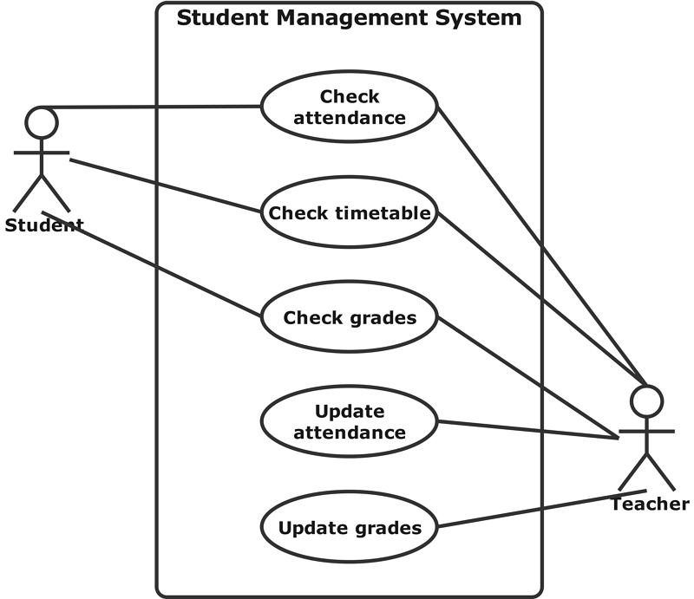
Use Case diagram

Slide 24
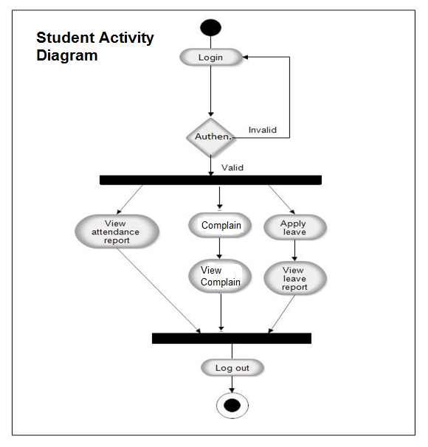
Activity Diagram

Slide 25
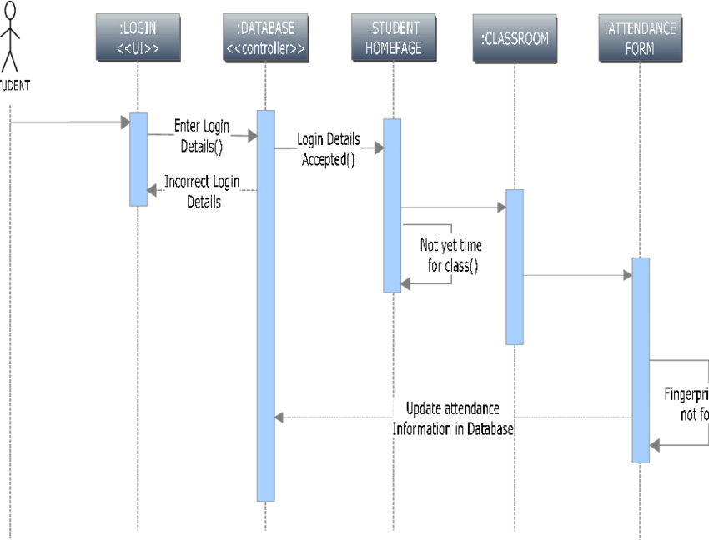
Sequence Diagram

Slide 26


Acknowledgement
www.presentationpoint.com
Ram Baugh J., etc., Object Oriented Modeling and Design, Prentice Hall of India, 1996.

